Slide 1



Basics of Algorithmization and Program
Prepared & Presented by: Mirlan Nurbekov, Lecturer
Office hours: Friday 8:00–17:00
AlaToo IT & Business College
Fall 2025

Slide 2

Activity lab 0011
Today I’ll walk you through the 5 lab tasks you were supposed to solve. We’ll look at my solutions, discuss the algorithms, and understand why each technique is used.

Slide 3

Overview
We will analyze 5 tasks:
Merge Sort Binary Search KMP Pattern Matching N-Queens Backtracking Dijkstra’s Shortest Path

Slide 4
Q1 — MERGE SORT
Problem Description
Write a program to sort a list of integers using Merge Sort.
The user inputs n numbers → output sorted list.
Concepts involved:
Recursion
Divide & conquer
Merging two sorted halves

Slide 5
THINK
Goal: sort a list of integers using merge sort.
Input: n numbers from the user.
Output: numbers sorted in ascending order.
Merge sort is one of the most reliable and widely used sorting methods, especially when large datasets are involved.

Slide 6
Why merge sort uses recursion?
Key idea: Divide and Conquer
Divide the array into two halves
Recursively sort each half
Merge them back together
Why recursion?
The algorithm naturally splits until 1-element arrays
Recursion reduces complexity of logic
Easy to express “divide” and “merge” steps

Slide 7

THE KEY IDEA
Merge Sort without recursion becomes unnecessarily complicated. Recursion fits the algorithm’s structure naturally.

Slide 8
How merging works
When merging two sorted arrays:
Compare the first elements
Move the smaller into a temporary array
Repeat until both halves are empty
Copy back results to the original array
Important performance note:
Merging always takes O(n) time.
Full algorithm is O(n log n).

Slide 9
Code walkthrough
The mergeSort(...) method calls itself on smaller segments
The base case is when the segment has 1 element
The merge(...) method combines two sorted subarrays
Temporary arrays are used to keep merging simple

Slide 10
Q2 — BINARY SEARCH
Problem Description
Implement Binary Search to find if a given number exists in a sorted array.
Ask the user for the number and display the index if found.

Slide 11
THINK
Goal: check if a number exists in a sorted array using binary search.
Input: n numbers and a target number.
Output: index of the number or a message saying it was not found.
Binary search only works correctly if the array is sorted.

Slide 12
Why binary search is efficient
Binary search repeatedly halves the search space:
check the middle element
if the target is smaller → search the left half
if larger → search the right half
It reduces the number of comparisons dramatically. Example: with one million items, binary search needs around 20 steps.
The difference between o(log n) and o(n).

Slide 13
Q2 code explanation
The array is sorted before searching
Low, high, and mid define the boundaries of the current search area
The loop continues while low ≤ high
The method returns the index if found, or −1 otherwise

Slide 14
Q3 — STRING PROCESSING
Implement the Knuth-Morris-Pratt (KMP) string-matching algorithm. Ask the user for a main string and a pattern, then print all positions where the pattern appears.

Slide 15
THINK
Goal: find all positions where a pattern appears inside a text using the kmp algorithm.
Key idea: KMP avoids repeating comparisons by using a prefix table (also called LPS array).

Slide 16
Why kmp avoids redundant comparisons?
A naive string search may re-check characters many times.
KPM improves this by:
Building the prefix table (LPS)
Jumping forward when mismatch happens
Using knowledge about previous matches
the algorithm runs in linear time: o(n + m).
this is important for long texts.

Slide 17
Understanding the prefix table (lps)
It is the key optimization in KPM The lps array represents: the longest proper prefix of the pattern that is also a suffix
Example: pattern: “ababc” lps: [0, 0, 1, 2, 0]
See code i created for this task in my github https://github.com/AlaTooMirlanNurbekov/A004_Basics_of_Algorithmization_and_Programming/tree/main/0002_codes/A0011

Slide 18
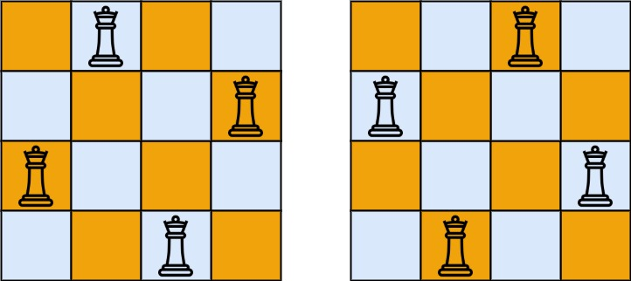
Q4 - N-QUEENS
Write a recursive program to place N queens on an N×N chessboard so that no two queens attack each other. Print one valid arrangement.

Slide 19
THINK
Goal: place n queens on an n×n board so that none attack each other.
Output: one valid arrangement of queens.
This problem demonstrates pure recursive thinking and structured backtracking.

Slide 20
Why backtracking is needed?
In n-queens, many placements look possible at first but later become invalid.
Backtracking means:
place a queen
check if the board is still valid
if later a conflict appears, undo the move
try the next possible column
This imitates how humans solve puzzles: try → check → undo → try again.

Slide 21
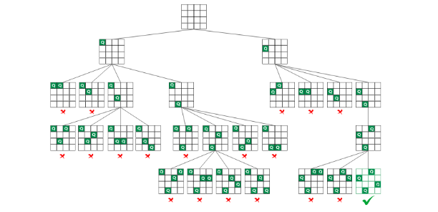
Checking validity
A QUEEN cannot share:
column
row
diagonal

Slide 22

Checking validity
See my code - same column above - upper-left diagonal - upper-right diagonal
This ensures all queens stay safe.

Slide 23
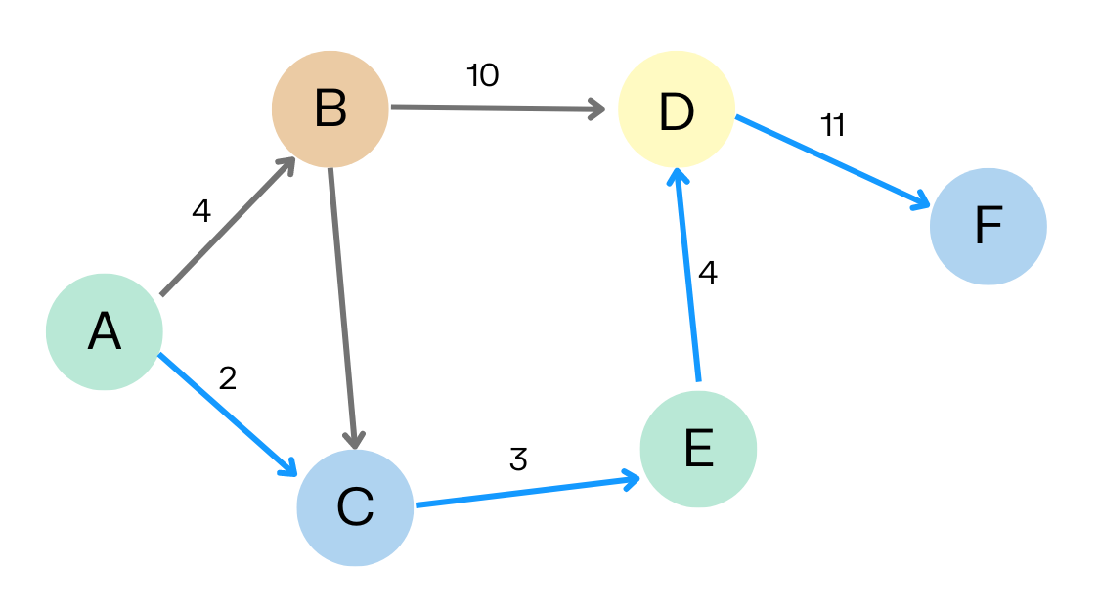
Q5 - GRAPH
Represent a weighted graph using an adjacency matrix and find the shortest path from a starting vertex using Dijkstra’s Algorithm.

Slide 24
THINK
Goal: find the shortest path from a starting vertex in a weighted graph.
Representation: graph stored as an adjacency matrix.
Output: distance from the starting vertex to all other vertices.

Slide 25
How dijkstra works?
Dijkstra uses a greedy strategy:
choose the vertex with the smallest known distance
update distances to its neighbors
mark the vertex as processed
repeat
This ensures we always expand the “closest” vertex first.

Slide 26
Why we use a minimum distance array
The code uses:
distance array
visited array
findMinVertex(...) method
This replaces a formal priority queue but works the same way for learning purposes.
The idea is to always pick the vertex with the lowest temporary distance, which improves performance compared to scanning all possibilities blindly.

Slide 27
Wrap up
-Merge sort uses recursion and merging to achieve o(n log n) sorting
-Binary search efficiently finds elements in sorted arrays
-KPM uses the prefix table to skip repeated comparisons
-N-queens demonstrates recursion and backtracking
- Dijkstra finds shortest paths using a greedy approach and a distance table

Slide 28
Self-test
1. Explain why Merge Sort uses a “divide and conquer” approach. How does splitting the array help make the sorting process faster?
2. Describe how Binary Search reduces the search space at every step. What happens after comparing with the middle element?
3. What is the purpose of the LPS (prefix) table in KMP, and how does it prevent repeated comparisons during pattern searching?

Slide 29
Self-test
4. In the N-Queens problem, why do we sometimes need to “undo” a queen’s placement? Describe how backtracking helps find a valid solution.
5. Explain how Dijkstra chooses which vertex to process next. Why is selecting the smallest known distance important?

